Slide 1
Banking Application
By: Dennis Vargas

Slide 2
About
Banking application
Make transactions
Create loan applications
Create/Manage customer accounts

Slide 3
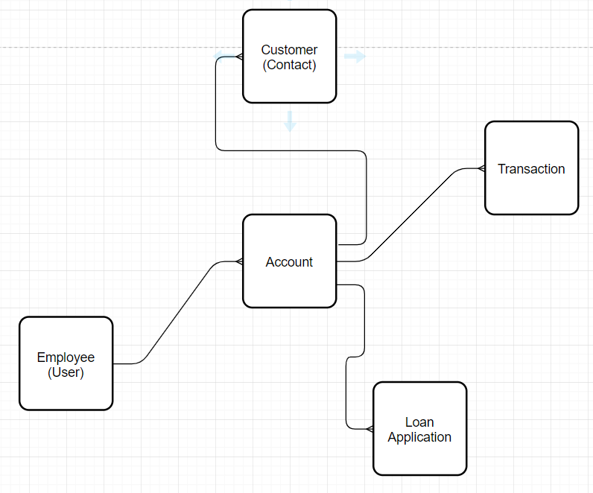
Entity Relationship Diagram

Slide 4
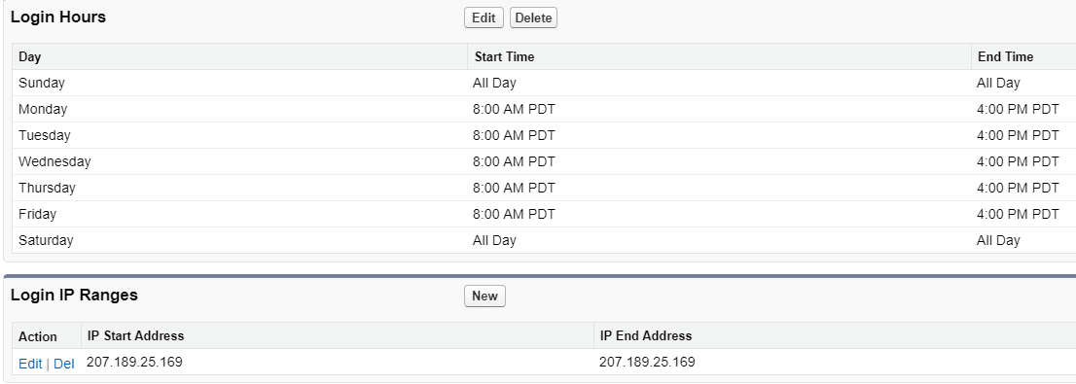
Org level Security

Slide 5
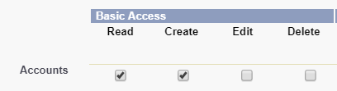
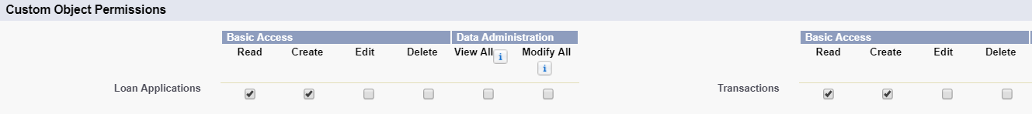
Object Level Security

Slide 6
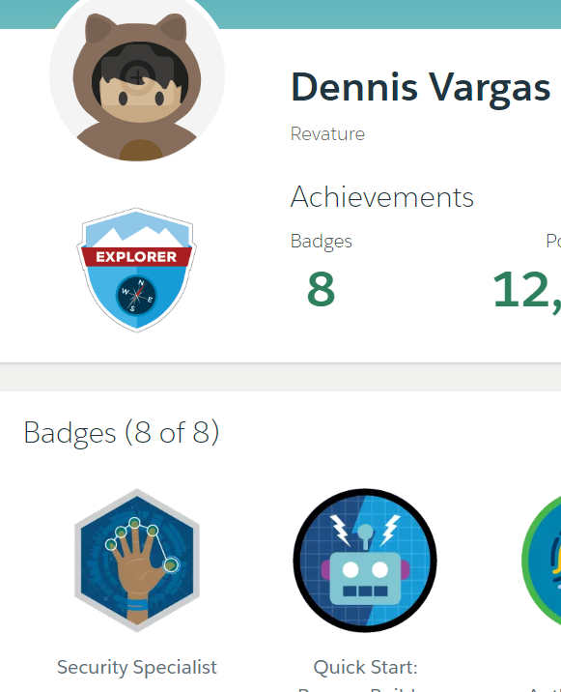
Security Specialist Badge

Slide 7
Demo

